Slide 1
Reading at St Mary’s
Key Stage 1 Parent’s Workshop

Slide 2
Children who read books often at age 10 and more than once a week at age 16 gain higher results in maths, vocabulary and spelling tests at age 16 than those who read less regularly
Why is reading so important?
OECD “Reading for Change” found that
“Being more enthusiastic about reading and a frequent reader was more of an advantage, on its own, than having well-educated parents in good jobs”
Imagination is more important than knowledge. For while knowledge defines all we currently know and understand, imagination points to all we might yet discover and create. - Albert Einstein
Children who read books often at age 10 and more than once a week at age 16 gain higher results in maths, vocabulary and spelling tests at age 16 than those who read less regularly
Recent research by the National Literacy Trust found a link between reading and mental wellbeing, so sharing a bedtime story with your child could help to improve their emotional health.

Slide 3
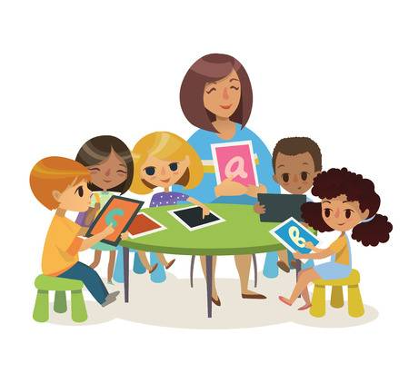
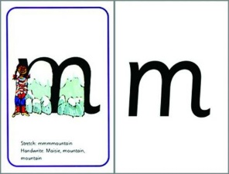
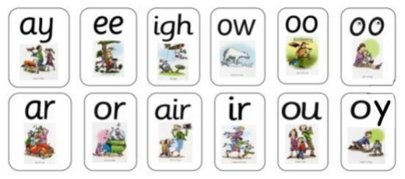
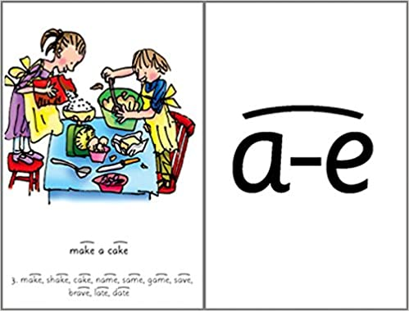
Children who read books often at age 10 and more than once a week at age 16 gain higher results in maths, vocabulary and spelling tests at age 16 than those who read less regularly
How do we teach reading in school?
Phonics
* We teach 6 phases of phonics, from phase 1 which teaches children how to listen to sounds to phase 6 which teaches them spelling patterns once they have learnt all the graphemes.
* We teach phonics everyday for half an hour.
*In each phonics lesson we recap graphemes we know, learn a new grapheme, practise writing with the new grapheme and read a book that has lots of words with the new grapheme in.
* We are assessed each half term and given targeted support where necessary.
*In our phonics lessons we also learn how to write the letters, making sure they face the correct way.

Slide 6
Children who read books often at age 10 and morhttps://www.youtube.com/watch?v=UCI2mu7URBce than once a week at age 16 gain higher results in maths, vocabulary and spelling tests at age 16 than those who read less regularly
How to support at home- Phonics
Phase 3
https://www.youtube.com/watch?v=UCI2mu7URBc
Phase 4

Slide 7
Children who read books often at age 10 and morhttps://www.youtube.com/watch?v=UCI2mu7URBce than once a week at age 16 gain higher results in maths, vocabulary and spelling tests at age 16 than those who read less regularly
How to support at home- Phonics
Phase 5
Phase 6

Slide 8
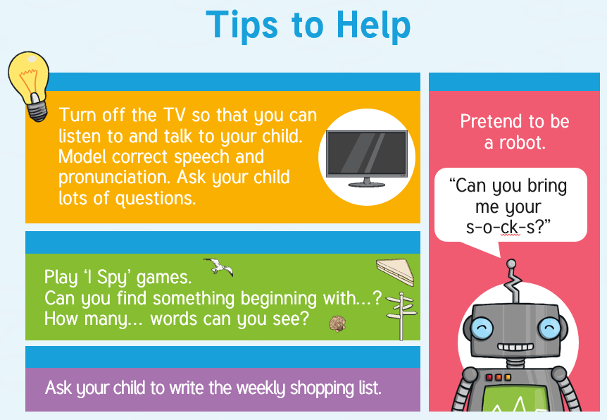

Slide 9
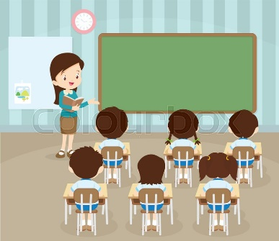
Children who read books often at age 10 and more than once a week at age 16 gain higher results in maths, vocabulary and spelling tests at age 16 than those who read less regularly
How do we teach reading in school?
Whole class reading
*The whole class take part in the lesson- they all look at the same book.
*The teacher reads, modelling how to read with expression, use strategies to work out unfamiliar words and show how punctuation may change how you read aloud.
* The child then reads. This might be out loud to the whole class, out loud all together, to a partner or silently.
*The teacher then asks a range of questions about what has been read to check that pupils have understood the text.

Slide 10
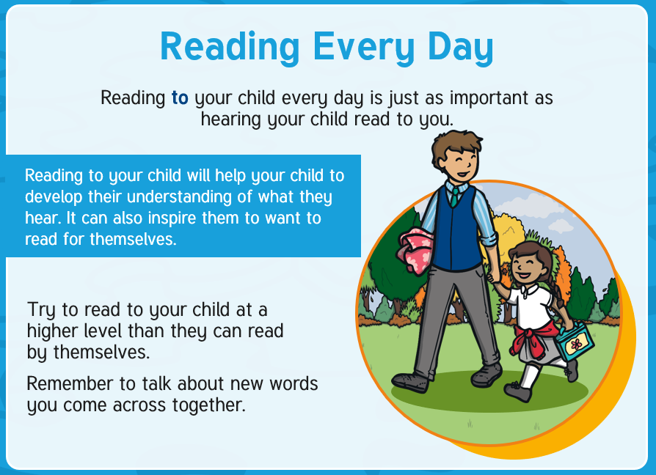
Children who read books often at age 10 and more than once a week at age 16 gain higher results in maths, vocabulary and spelling tests at age 16 than those who read less regularly
How to support at home- reading to your child

Slide 11
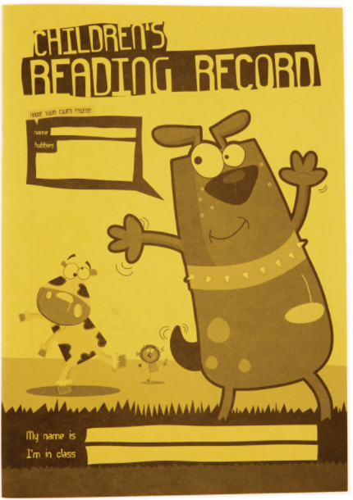
Children who read books often at age 10 and more than once a week at age 16 gain higher results in maths, vocabulary and spelling tests at age 16 than those who read less regularly
How do we teach reading in school?
Individual reading
* All children in Key stage one will individually read to an adult at least once or twice a week.
* Some children who are finding reading more challenging will read to an adult more often.
With the adult they will:
Discuss what they think the story might be able based on the title and front cover.
Discuss if they think it might be fiction or non fiction and why.
Read each page. The adult might ask them to check if something they read makes sense and they will encourage them to use a range of strategies to read unfamiliar words.
They will ask questions about what they have read to check for understanding.
They may ask to predict events or talk about how this is similar to other books they may have read.
They may ask why the author has used certain words or set the book out in a certain way.
* The adult will write in the home reading record so you can see how well they have done and you can give them lot of praise.

Slide 12
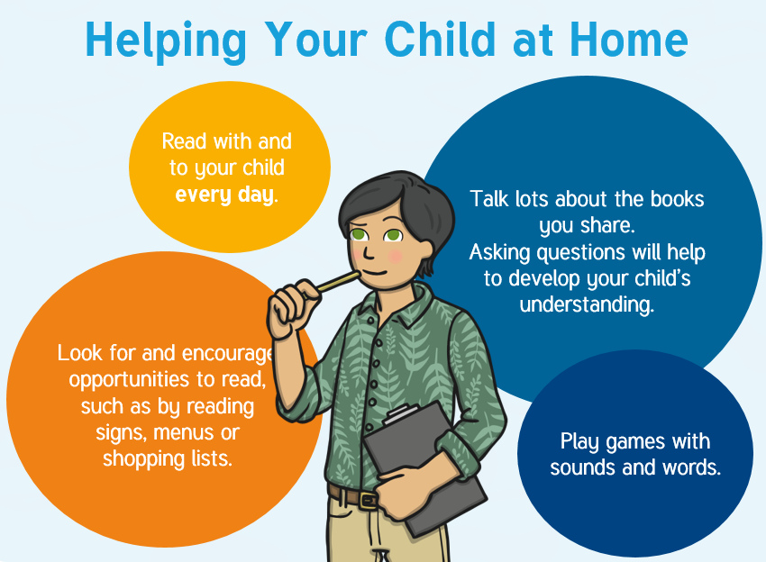
Children who read books often at age 10 and more than once a week at age 16 gain higher results in maths, vocabulary and spelling tests at age 16 than those who read less regularly
How to support at home- listening to your child read

Slide 13
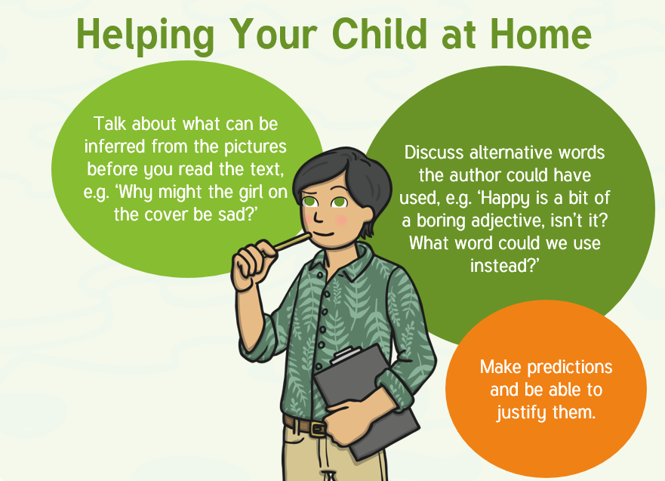

Slide 15
Children who read books often at age 10 and more than once a week at age 16 gain higher results in maths, vocabulary and spelling tests at age 16 than those who read less regularly
How do we teach reading in school?
Comprehension

Slide 16
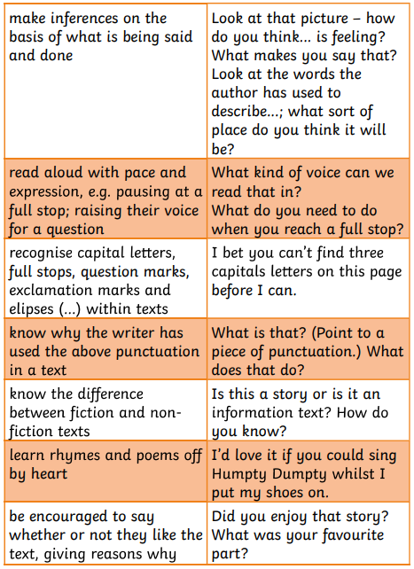
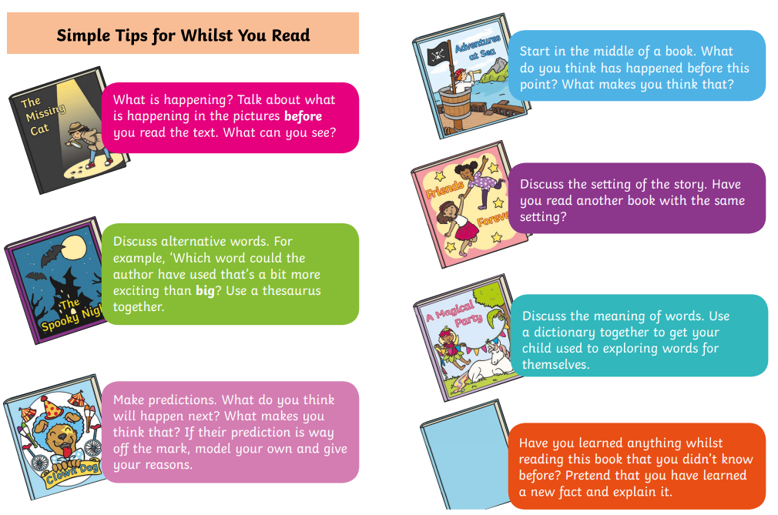
Children who read books often at age 10 and more than once a week at age 16 gain higher results in maths, vocabulary and spelling tests at age 16 than those who read less regularly
How to support at home- understanding the text Y1

Slide 17
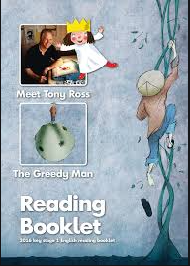
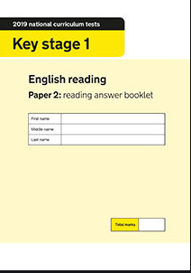
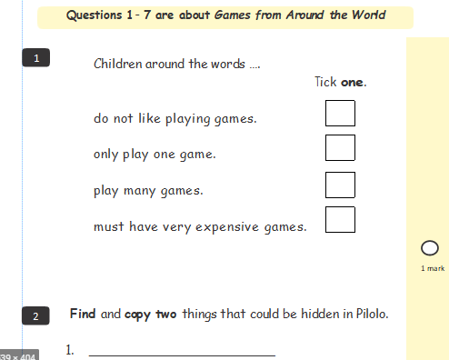
Children who read books often at age 10 and more than once a week at age 16 gain higher results in maths, vocabulary and spelling tests at age 16 than those who read less regularly
How to support at home- understanding the text Y2

Slide 18
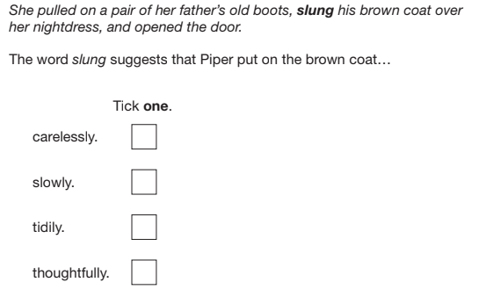
_______________________________________________
Tick one
______________________________
______________________________
______________________________
______________________________

Slide 19
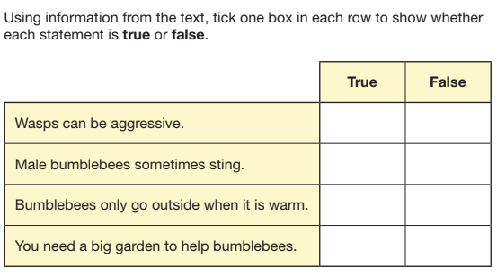
Using information from the text, tick one box in each row to show whether each statement is true or false
 | True | False

Slide 20
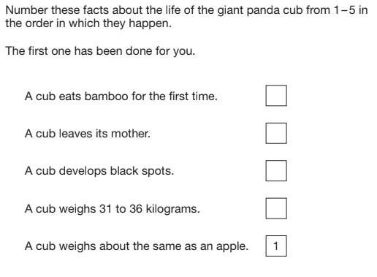

Slide 21
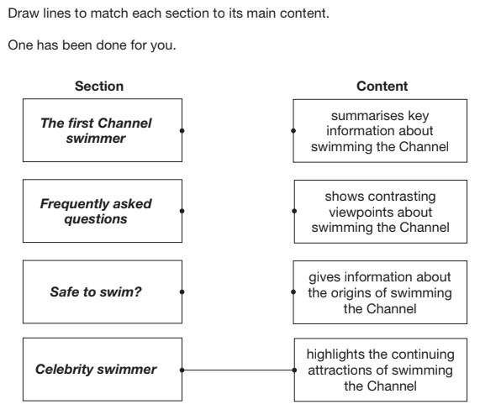

Slide 22
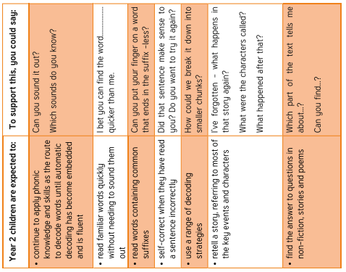
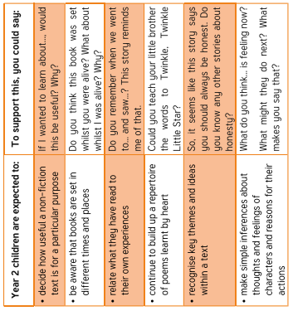
Children who read books often at age 10 and more than once a week at age 16 gain higher results in maths, vocabulary and spelling tests at age 16 than those who read less regularly
How to support at home- understanding the text Y2

Slide 23
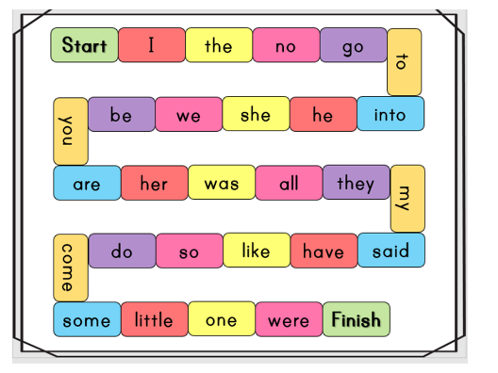
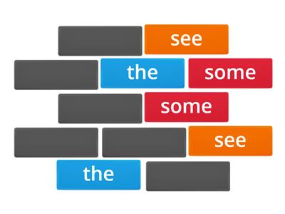
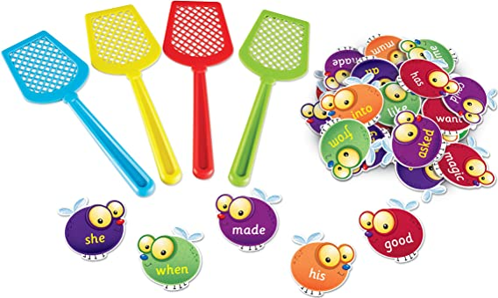
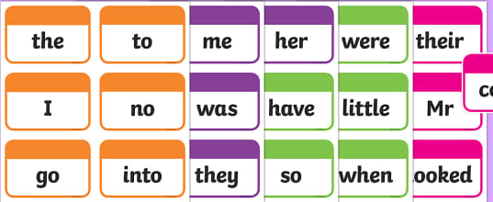
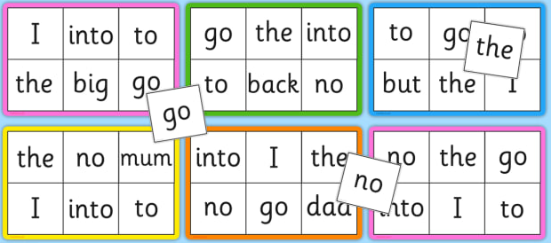
Children who read books often at age 10 and more than once a week at age 16 gain higher results in maths, vocabulary and spelling tests at age 16 than those who read less regularly
How do we teach reading in school?
Tricky Words
Board Games
Active Games
Pairs
Flashcards
Bingo

Slide 26
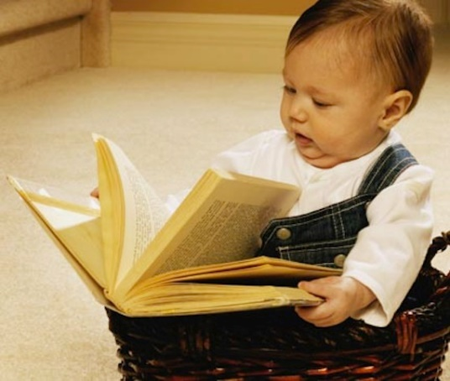
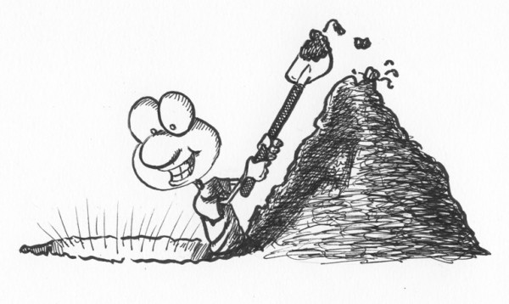
Children who read books often at age 10 and more than once a week at age 16 gain higher results in maths, vocabulary and spelling tests at age 16 than those who read less regularly
How to support at home- Greater Depth readers
Some children will be working above the expected level for their age in reading, we call this ‘Greater Depth’.
There is sometimes a temptation to move children onto more challenging texts because they can read the words, but they may not always have the maturity to understand the text. Instead we encourage ‘Greater Depth’ pupils to ‘Dig Deeper’.
This means using an age appropriate text and asking increasingly complex questions to help them to understand the text better.

Slide 27
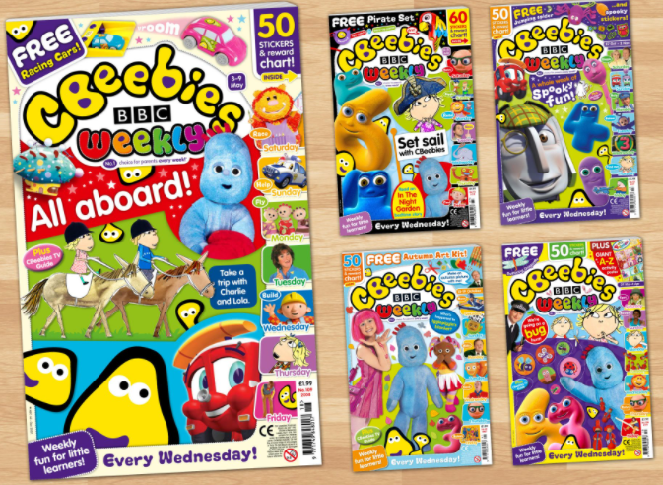
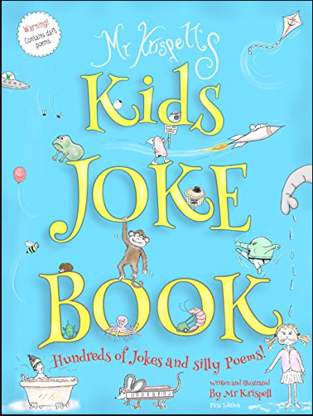
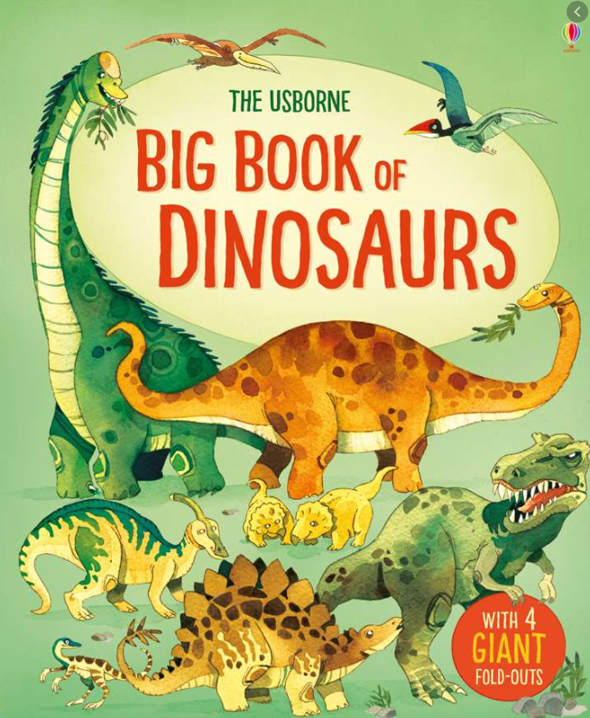
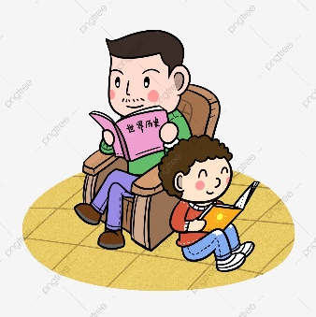
Children who read books often at age 10 and more than once a week at age 16 gain higher results in maths, vocabulary and spelling tests at age 16 than those who read less regularly
How to support at home- reluctant readers
Find something they love to read!
Something funny
Something factual
A series that they can ‘collect’
An audiobook/Ebook
Make reading time special
Don’t put pressure on them to read every sentence perfectly
Let them see you reading for pleasure

Slide 28
Teach your Monster to read app
https://www.teachyourmonstertoread.com/
Oxford Owls website:
https://home.oxfordowl.co.uk/
100 high frequency words: http://www.greatlittleminds.com/pages/100-high-frequency-words-phases.html
vocabulary and spelling tests at age 16 than those who read less regularly
Useful links

Slide 29
Children who read books often at age 10 and more than once a week at age 16 gain higher results in maths, vocabulary and spelling tests at age 16 than those who read less regularly

