Slide 1


Reading at St Mary’s
Lower Key Stage 2 Parent’s Workshop

Slide 2




Children who read books often at age 10 and more than once a week at age 16 gain higher results in maths, vocabulary and spelling tests at age 16 than those who read less regularly
Why is reading so important?
OECD “Reading for Change” found that
“Being more enthusiastic about reading and a frequent reader was more of an advantage, on its own, than having well-educated parents in good jobs”
Imagination is more important than knowledge. For while knowledge defines all we currently know and understand, imagination points to all we might yet discover and create.
- Albert Einstein
Children who read books often at age 10 and more than once a week at age 16 gain higher results in maths, vocabulary and spelling tests at age 16 than those who read less regularly
Recent research by the National Literacy Trust found a link between reading and mental wellbeing, so sharing a bedtime story with your child could help to improve their emotional health.

Slide 3
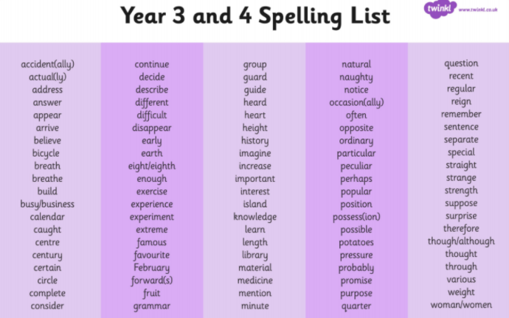
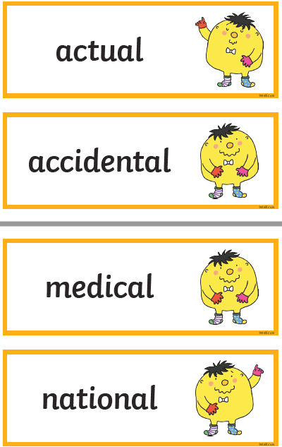
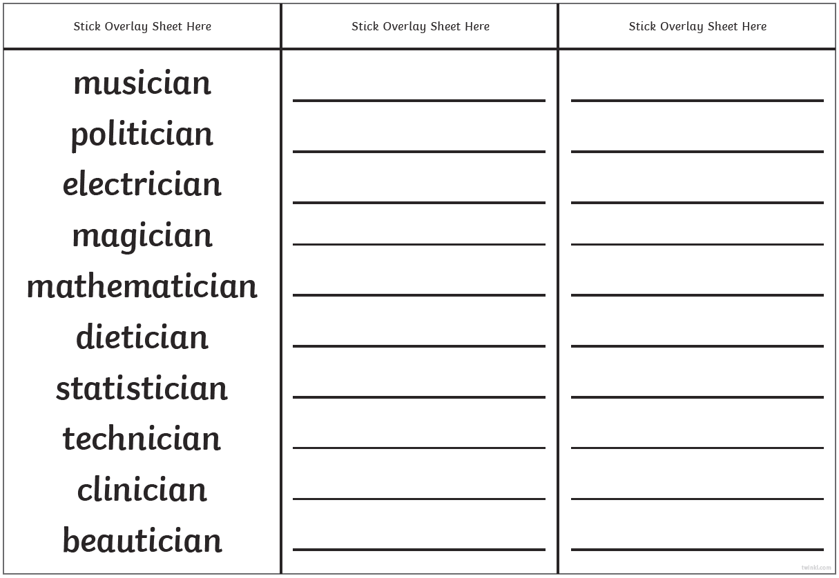

Children who read books often at age 10 and more than once a week at age 16 gain higher results in maths, vocabulary and spelling tests at age 16 than those who read less regularly
How do we teach reading in school?
Phonics and Spelling
In Key Stage One, pupils will have been taught how to read all of the graphemes in the English Language. Although they will have been taught this, it may still need reinforcing and spelling patterns will need explicitly teaching.
Each week, pupils will be given ten new spellings to learn. They will be tested on these spellings and will be expected to read these words if they appear in books without sounding out the words.

Slide 4
Children who read books often at age 10 and more than once a week at age 16 gain higher results in maths, vocabulary and spelling tests at age 16 than those who read less regularly
How to support at home- Spelling
Your child will bring home a list of spellings with them every week with their home learning book.
We advise you to encourage them to practise these daily.
Find out what the word means by looking it up in a dictionary.
Why not write a sentence for each word, so that your child knows how to use each word correctly?
Spellings will be tested every week –
In Year 3 the test day is on a Friday.
In Year 4 the test day is on a Friday.
Year 3 and 4 children have a copy of the half term’s spelling lists before each half term begins, so that they have the spellings in advance.

Slide 5
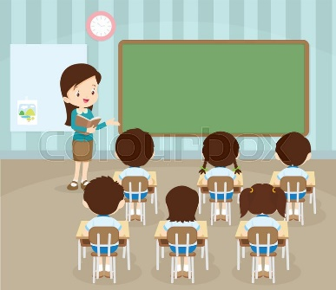

Children who read books often at age 10 and more than once a week at age 16 gain higher results in maths, vocabulary and spelling tests at age 16 than those who read less regularly
How do we teach reading in school?
Whole class reading
*The whole class take part in the lesson- they all look at the same book.
*The teacher reads for ten minutes, modelling how to read with expression, use strategies to work out unfamiliar words and show how punctuation may change how you read aloud.
* The child then reads. This might be out loud to the whole class, out loud all together, to a partner or silently.
*The teacher then asks a range of questions about what has been read to check that pupils have understood the text.

Slide 6
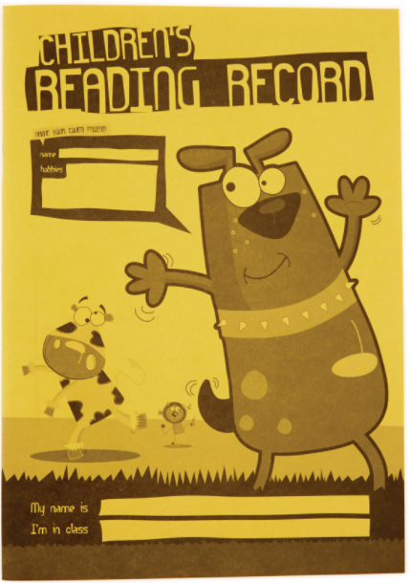
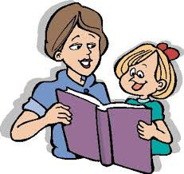
Children who read books often at age 10 and more than once a week at age 16 gain higher results in maths, vocabulary and spelling tests at age 16 than those who read less regularly
How to support at home- listening to your child read
As we all know, there is more to hearing your child read their book than simply reading. Here are some tips to help during reading sessions at home:
What is happening? – Talk about the pictures before you start to read the text. What can you see?
Discuss the meaning of words – Use a dictionary to get your child used to exploring words for themselves.
Discuss alternative words. For example. ‘big’. Can you think of another word that means the same? e.g. ‘huge’ (use a thesaurus).
Make predictions. What do you think will happen next? What makes you think that?
Start at the end of the book – What do you think happened before this? Why do you think that?
Discuss feelings. How do you think the characters are feeling? What has made them feel this way?
Where is the story set? Have you read another story with the same setting?
Discuss the problem in the story. What has happened? What went wrong?
Discuss the resolution. How was the problem solved? Is there another way that it could have been resolved?
Fact or fiction? – Is the book a story book or a on-fiction book? How do you know?
What have your learnt? What do you know now that you didn’t know before reading the
book?

Slide 7
Children who read books often at age 10 and more than once a week at age 16 gain higher
How to support at home- listening to your child read
During Reading.
Encourage your child to use expression as they read aloud, especially for the voices of the different characters.
Discuss the punctuation on the page, for example, exclamation marks. What are these used for? What should you do when you see an exclamation mark?
You do not always have to read the entire book every night. Focus on 2 pages and talk about the characters, setting and plot in a lot of detail. You might want to take it in turns to read so that your child can hear how you read.

Slide 8
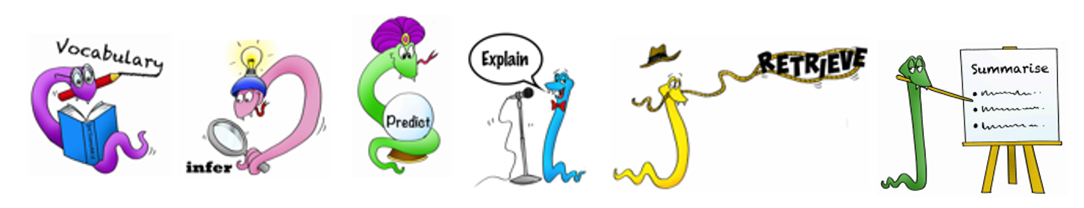
Children who read books often at age 10 and more than once a week at age 16 gain higher results in maths, vocabulary and spelling tests at age 16 than those who read less regularly
How do we teach reading in school?
Comprehension
VIPERS is an acronym to aid the recall of the 6 reading domains as part of the UK’s reading curriculum.
They are the key areas which we feel children need to know and understand in order to improve their comprehension of texts.
VIPERS stands for:
Vocabulary
Inference
Prediction
Explanation
Retrieval
Sequence or Summarise

Slide 9

Children who read books often at age 10 and more than once a week at age 16 gain higher results in maths, vocabulary and spelling tests at age 16 than those who read less regularly
How do we teach reading in school?
Comprehension
The 6 domains focus on the comprehension aspect of reading and not the mechanics: decoding, fluency, prosody (the patterns of rhythm and sound used in poetry or the patterns of stress and intonation in a language). etc.
As such, VIPERS is not a reading scheme but rather a method of ensuring that teachers ask, and students are familiar with, a range of questions.
They allow the teacher to track the type of questions asked and the children’s responses to these which allows for targeted questioning afterwards.

Slide 10
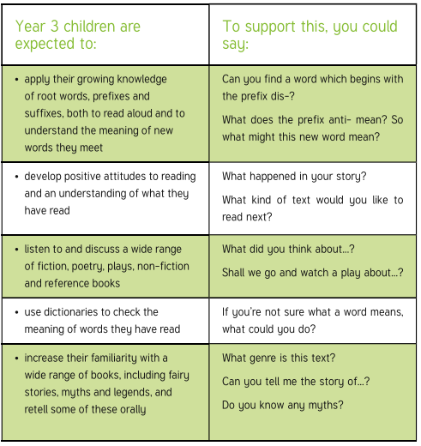
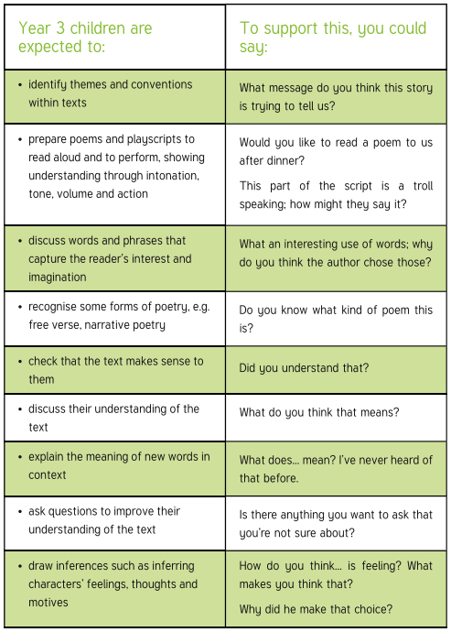
Children who read books often at age 10 and more than once a week at age 16 gain higher results in maths, vocabulary and spelling tests at age 16 than those who read less regularly
How to support at home- understanding the text Y3

Slide 11
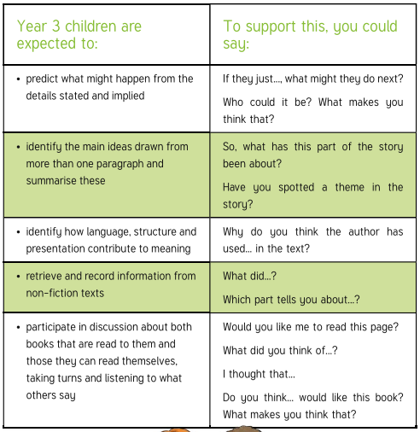
Children who read books often at age 10 and more than once a week at age 16 gain higher results in maths, vocabulary and spelling tests at age 16 than those who read less regularly
How to support at home- understanding the text Y3

Slide 12
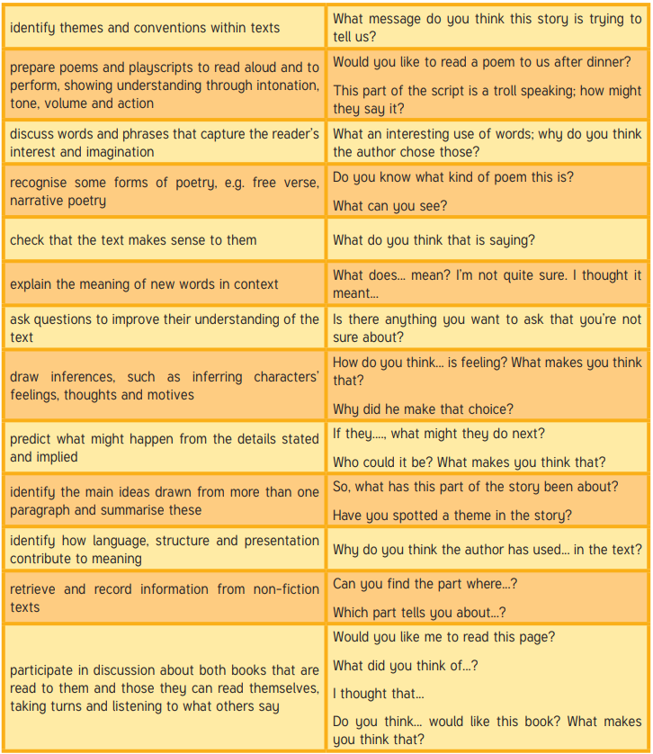
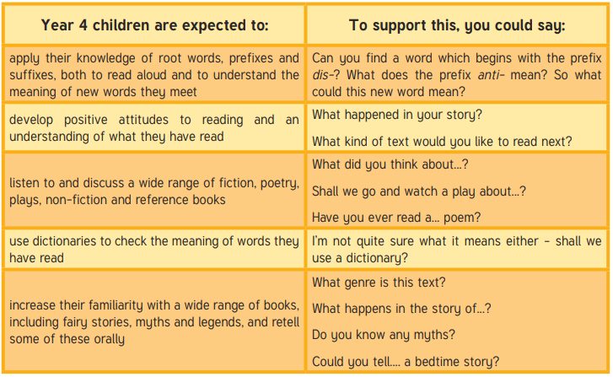
Children who read books often at age 10 and more than once a week at age 16 gain higher results in maths, vocabulary and spelling tests at age 16 than those who read less regularly
How to support at home- understanding the text Y4

Slide 13

Children who read books often at age 10 and more than once a week at age 16 gain higher results in maths, vocabulary and spelling tests at age 16 than those who read less regularly
How do we teach reading in school?
Individual reading
Once pupils have entered Key Stage 2, most pupils no longer read 1-1 with an adult in school.
A handful of children who are working significantly behind their peers for reading, will read with an adult several times a week or daily to help them to make progress to catch up to their classmates. You will be informed if your child is having this additional support.

Slide 14
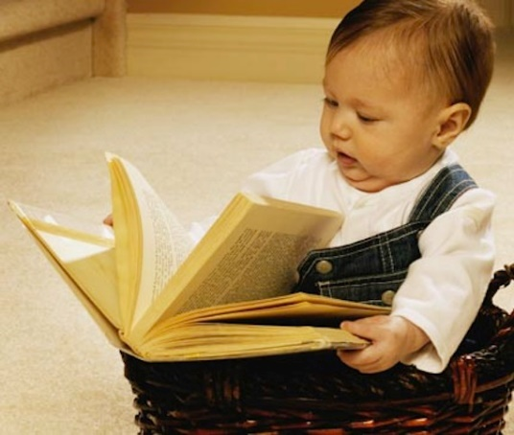
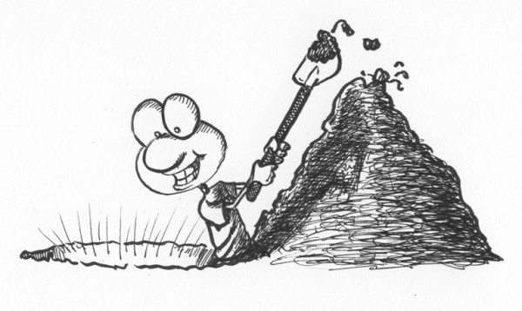
Children who read books often at age 10 and more than once a week at age 16 gain higher results in maths, vocabulary and spelling tests at age 16 than those who read less regularly
How to support at home- Greater Depth readers
Some children will be working above the expected level for their age in reading, we call this ‘Greater Depth’.
There is sometimes a temptation to move children onto more challenging texts because they can read the words, but they may not always have the maturity to understand the text.
Instead we encourage ‘Greater Depth’ pupils to ‘Dig Deeper’. This means using an age appropriate text and asking increasingly complex questions to help them to understand the text better.

Slide 15


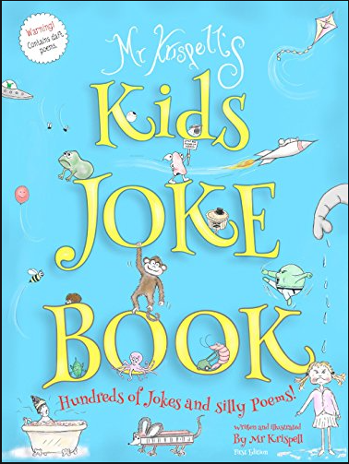
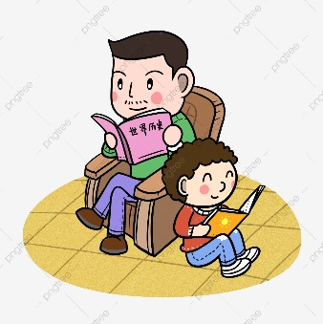
Children who read books often at age 10 and more than once a week at age 16 gain higher results in maths, vocabulary and spelling tests at age 16 than those who read less regularly
How to support at home- reluctant readers
Find something they love to read!
Something funny
Something factual
A series that they can ‘collect’
An audiobook/E-book
Make reading time special
Don’t put pressure on them to read every sentence perfectly
Let them see you reading for pleasure

Slide 16
Children who read books often at age 10 and more than once a week at age 16 gain higher results in maths, vocabulary and spelling tests at age 16 than those who read less regularly
Useful links
A Story For Bedtime This is a community sharing site for parents and children. You can download MP3 files of stories to play to children, these can be burned to CD or loaded onto an MP3 player. Rather than professionally produced audio books, the stories are recordings of parents reading stories to their children. You can also record your own stories and send them in to the site. Users who register on the site can post in the discussion forums, comment on stories and also submit new stories, songs and drawings so that everyone can share them. www.astoryforbedtime.com
BBC's Digger and the Gang This BBC website was developed in partnership with the Department for Education and Skills to guide children aged five to 11 and their parents through the National Curriculum in England. www.bbc.co.uk/education/schools/digger
Booktrust This is an independent charity that works to bring together readers and books. It runs the books for babies project Bookstart, funded by Sainsbury's. The site includes lots of information on books for children and adults, and book prizes. www.booktrust.org.uk
The Child Literacy Centre. The Child Literacy Centre offers information for parents on methods used to teach reading to their children in school, and advice and tips on activities to share in the home. www.childliteracy.com

Slide 17
Children who read books often at age 10 and more than once a week at age 16 gain higher results in maths, vocabulary and spelling tests at age 16 than those who read less regularly
Useful links
Craigmillar Books for Babies - This website of an individual Bookstart project has general information useful for parents of young children, including nursery rhymes. www.craigmillarbooksforbabies.org.uk
DfES Parents Centre - The Parents Centre has been developed by the Department for Education and Skills to provide parents with information about raising children and supporting learning, both in and out of school. It covers a broad range of topics, from how they can help their children learn to information on school holiday dates and rules on uniforms. www.parentscentre.gov.uk
Familyrapp - Family-centred website offering guidance on a wide range of family issues, including family holidays and days out, education, health, recipes and shopping. It includes edurapp - advice and guidance on education - and book reviews and information for adults and children. www.familyrapp.co.uk
Fathers Direct - The website of Fathers Direct, a support organisation for dads, takes the form of an online magazine. It is a source of information by and for dads, and a site fathers can visit with their children. There are competitions, games, quizzes and discussion boards plus archived expert advice. You can also find the best books for children, as well as recommend your own favourites. www.fathersdirect.com

Slide 18
Children who read books often at age 10 and more than once a week at age 16 gain higher results in maths, vocabulary and spelling tests at age 16 than those who read less regularly
Useful links
Help Them Read - Site developed by a former head of special needs education to help parents to support children who are struggling with reading. Free assessment guidelines and sample materials are available but further modules must be purchased, as you need them. www.helpthemread.co.uk
Help your child discover ... - This part of the Department for Education and Skills' parents' site provides a range of guides to help parents and carers to understand and play an active part in their child's learning. Each guide focuses on a particular primary topic, giving information on what will be covered in school and how parents can help at home. www.dfes.gov.uk/parents/discover/
Parent Link Website created by teachers to explain to parents what children will be studying at primary school in English and maths. There are tips on how to help your child with maths, reading, spelling and writing. www.parentlink.co.uk
Read Together - Read Together is the website of the Scottish Executive's Home Reading Initiative, which aims to encourage parents and carers to share books with children. www.readtogether.co.uk
Silly Books - This is a site of free reading fun. There are animated cartoons with subtitles, comics, children's music, picture books, puzzles and games that entertain kids and teach them to read. www.sillybooks.net

Slide 19
Children who read books often at age 10 and more than once a week at age 16 gain higher results in maths, vocabulary and spelling tests at age 16 than those who read less regularly
Useful links
On Line Learning Websites
The following website is useful for all subjects and contains fact sheets explaining how to tackle tricky problems as well as online games and printable worksheets (with answers!) http://www.bbc.co.uk/schools

Slide 20

Children who read books often at age 10 and more than once a week at age 16 gain higher results in maths, vocabulary and spelling tests at age 16 than those who read less regularly

